Slide 1
Assignment 5
Group 6

Slide 2
Aspiration Windows implementation
Double between 0 and 1
Example: AspirationSize = 0,5; Heuristic score found in previous depth = 100
  Next Alpha: 50; Next Beta: 150
For the test:
  Multiples of 0,05
  Number of states and computation time measured

Slide 3
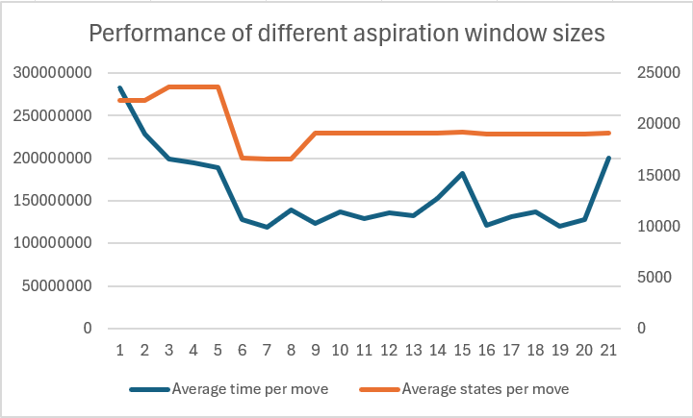
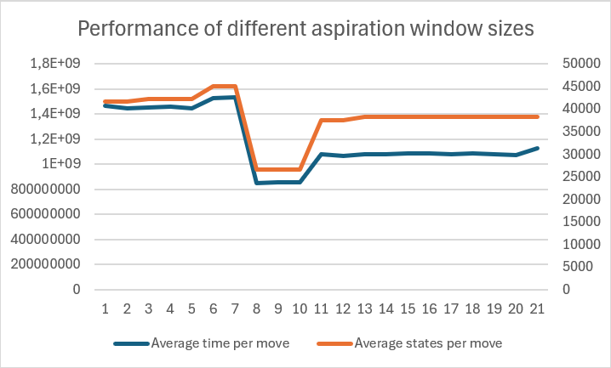
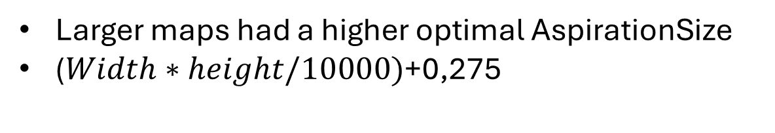
Test results on differently sized maps
Time in ns
Time in ns
Time in ns
Competetive Map (20x20)
Factor of 0,05
Pikatchu Map (50x50)
Larger maps had a higher optimal AspirationSize
($Width∗height/10000)$+0,275

Slide 4
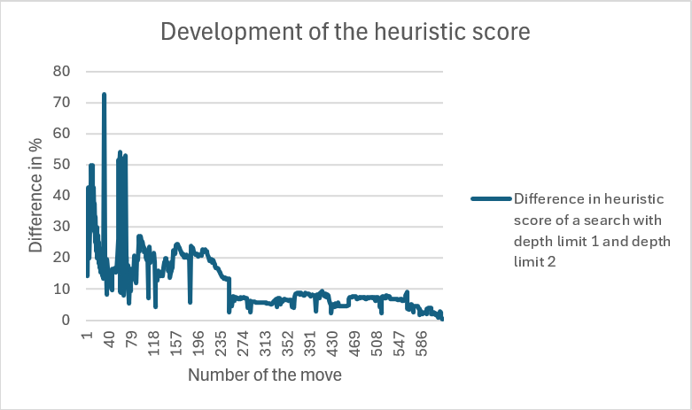
Planned improvements
Chess Map (50x50)
Optimal constant AspirationSize: 0,55
Non constant AspirationSize function

Slide 5
Time estimation
Task 1

Slide 6
Concept
Time measurement
pasttimes[]
DeepeningSearch(i)
Time measurement
Time estimation (i+1)
Time-estimation algorithm

Slide 7
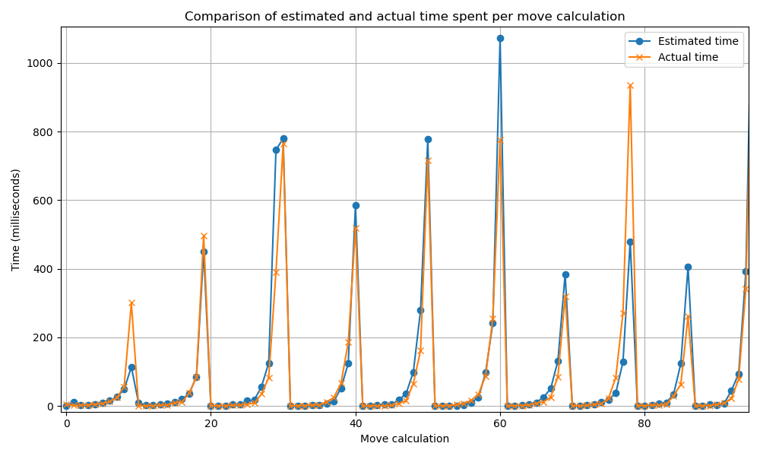
Results
First move less accurate
Shape very well matched
65% Success rate
Over/under -estimation tradeoff

Slide 8
Heuristics

Slide 9
parameters
Total stones
Side stones
Corner stones
"Bonus tiles"
Number of overrides

Slide 10
Parameters weighted
Total stones
Side stones
Corner stones
"Bonus tiles"
Number of overrides
*Weight referenced by color(green, blue, red)(low, middle, high)

Slide 11
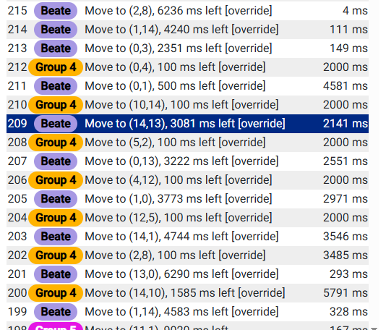
Stockpiling overrides
Four player map(14x14)
-> game state before this happens loses significance.

Slide 12
Inversions/ swaps
Relative player number

Slide 13
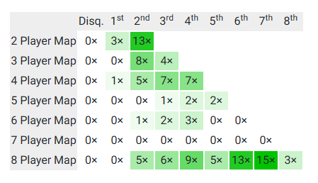
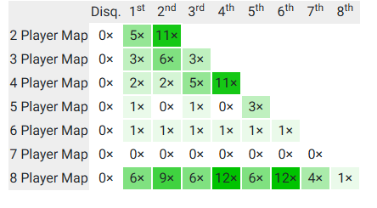
Results
Results pre improvement
Results after improvement
-> results especially in games with higher numbers of players improved significantly.

